Slide 1
Are You Ready To Do Your Part to Help Protect Your Gun Rights?
JOIN NRA!

Slide 2
Join NRA Today and Receive…
24/7 defense of your firearm freedom.

Slide 3
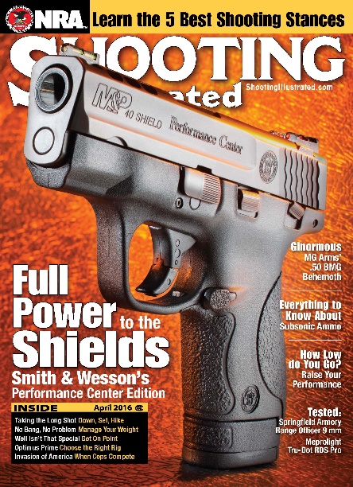
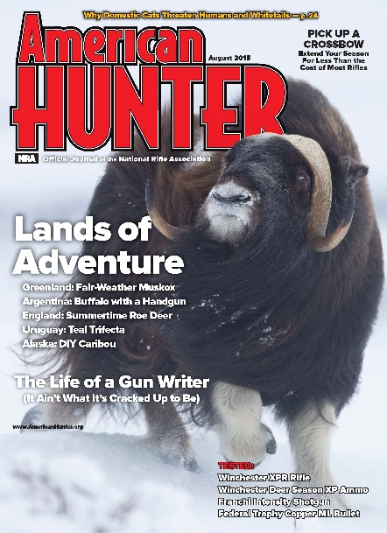
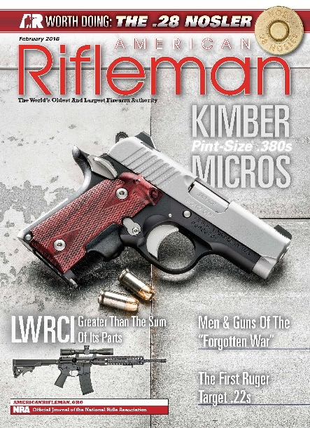
Join NRA Today and Receive…
Award Winning NRA Magazine
American Rifleman
American Hunter
America’s 1st Freedom
Shooting Illustrated

Slide 4
Join NRA Today and Receive…
NRA Hat*
Membership card
Window decal
*New Members Only

Slide 5
Join NRA Today and Receive…
$2,500 in ArmsCare® firearms insurance.
$5,000 Life & Accidental insurance ($10,000 for Life Members)

Slide 6
Join NRA Today and Receive…
Invitations to “Friends of NRA” dinners and auctions.

Slide 7
Join NRA Today and Receive…
Special savings at SavingUSA.com
Legislative Updates

Slide 8
Join NRA Today and Receive…
Discounts at over 6,000 hotels and motels nationwide.
Visit benefits.nra.org for more details

Slide 9
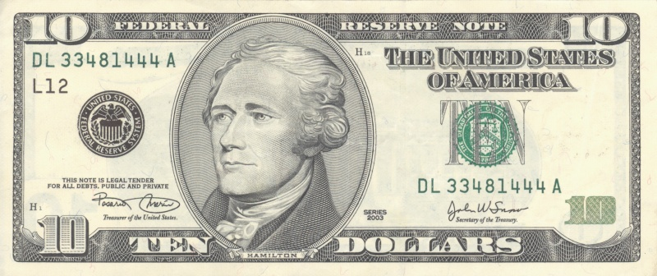
Join NRA Today and Receive…
$10.00 off a 1-Year membership when you join today, up to $40 off your membership!

Slide 10
Sign up through your instructor today!

